Slide 1




2019/11/6
智能系统原理与开发
第09章 智能推荐系统
Search – Information Retrieval
Know what you want
Query using key words
Return expected results
You find something!

Slide 2


2019/11/6
Recommendation – Information Discovery
Do not know its existence
Do not know how to find
Return serendipitous results
Something finds you!

Slide 3

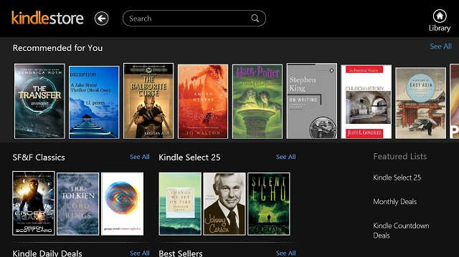
2019/11/6
October 2006, Netflix offered a $1,000,000 Grand Prize
The grand prize accelerated the research of recommendation
The winning team uses machine learning techniques
Outperforms “Cinematch” by 10%

Slide 4
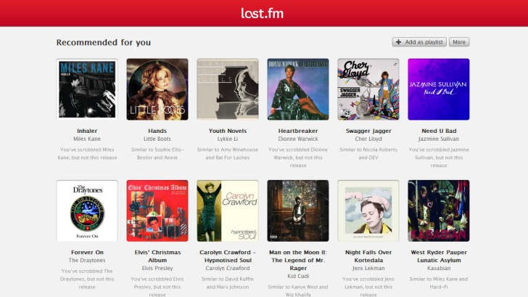
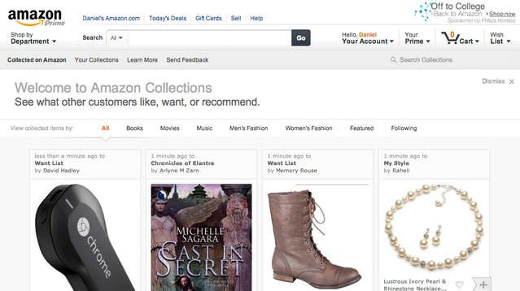
2019/11/6

Slide 5
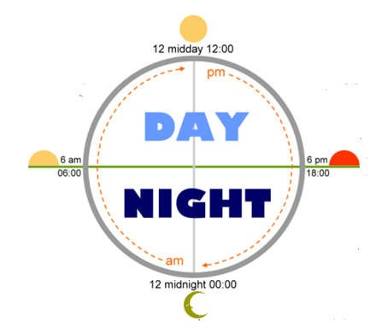

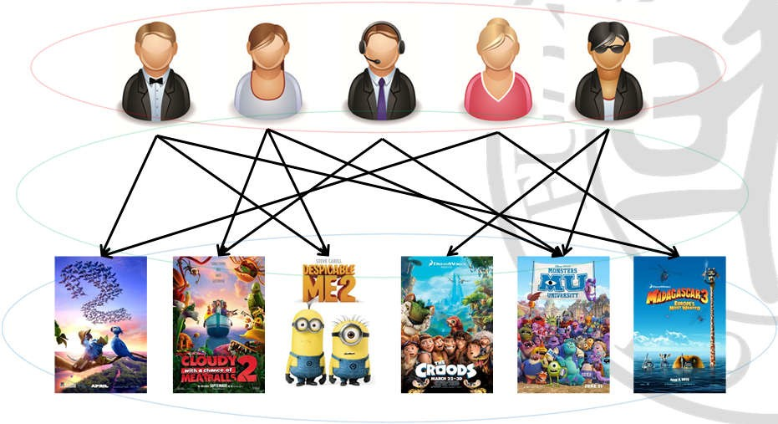











2019/11/6
Linkedin Jobs
Flipboard News
TripAdvisor Hotels
CiteULike Papers
Yummly Recipes
Qunar Itinerary
Amazon Products
Hulu Videos
Foursquare Venues
Netflix Movies
Kindle Books
Last.fm Music
Three key elements

Slide 6





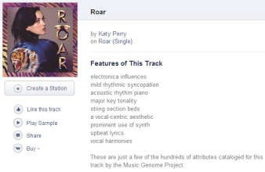
2019/11/6
User profiles用户画像
Basic: Genders, Ages, Occupations, Regions, etc.
Extra: Social relationships, User Tags, etc.
Male; Age 28; IT Engineer; US CA94035
[Tags] Travel, Steve Jobs, Photography, “TBBT”, …
Female; Age 20; Accounting; AU NSW2007
[Tags] Music, Taylor Swift, Katy Perry, “Gossip Girl”, …
Item attributes
Basic: Any form of descriptive data (e.g., movie metadata)
Extra: Item taxonomy分类法, knowledge base (e.g., Wikipedia)

Slide 7








2019/11/6
Preference (explicit)
Ratings
Likes
Preference (implicit)
Click-through
Purchased records
4 |  | 5 |  |  | 3
 | 3 | 4 |  | 3
 | 3 |  |  | 4
4 |  |  |  |  | 4
 |  |  | 2 | 5
Given user set
User profiles – optional
Given item set
Item attributes– optional
Given preference
Explicit/Implicit preference data– mandatory强制的
Real-world RSs tend to make full use of available data
The most basic RS problem only use preference data
–focus of the ML research for RS

Slide 8
2019/11/6
Goal
Predict ratings
Rank items
4 |  |  |  |  | 3
 | 3 | 4 |  | 3
? | 3 | ? | ? | 4 | ?
4 |  | 5 |  |  | 4
 |  |  | 2 | 5
UserID::Gender::Age::Occupation::Zip (user info file format)
Age is chosen from 7 ranges: * 1: "Under 18" * 18: "18-24" * 25: "25-
34" * 35: "35-44" * 45: "45-49" * 50: "50-55" * 56: "56+"
Occupation is chosen from 20 choices: * 0: "other" or not specified * 1: "academic/educator" * 2: "artist" * 3: "clerical/admin" * 4: "college/grad student" * 5: "customer service" * 6: "doctor/health care"
7: "executive/managerial" * 8: "farmer" * 9: "homemaker" * 10: "K-12
student" * 11: "lawyer" * 12: "programmer" * 13: "retired" * 14:
"sales/marketing" * 15: "scientist" * 16: "self-employed" * 17:
"technician/engineer" * 18: "tradesman/craftsman" * 19: "unemployed" * 20: "writer"
MovieID::Title::Genres (movie info file format)
Titles are provided by the IMDB (including year of release)
Genres are selected from 18 genres: * Action * Adventure * Animation
Children's * Comedy * Crime * Documentary * Drama * Fantasy * Film-Noir * Horror * Musical * Mystery * Romance * Sci-Fi * Thriller * War * Western
[1] Download at http://grouplens.org/datasets/movielens/

Slide 9



2019/11/6
UserID::MovieID::Rating::Timestamp
Ratings in 5-star scale {1,2,3,4,5}
Timestamp is represented in seconds (can be transformed into dd-mm-yyyy)
Training Data Test Data
user | movie | date | rate
1 | 34 | 11-04-02 | 3
1 | 296 | 09-05-02 | 4
2 | 11 | 18-01-02 | 5
2 | 59 | 23-02-02 | 4
2 | 124 | 03-04-02 | 2
3 | 58 | 05-07-02 | 3
user | movie | date | rate
1 | 75 | 21-02-03 | ?
1 | 126 | 09-03-03 | ?
2 | 92 | 18-01-03 | ?
2 | 257 | 29-05-03 | ?
3 | 66 | 22-03-03 | ?
3 | 394 | 02-06-03 | ?
Given a User-Info Matrix (optional): U
Given an Item-Info Matrix (optional): V
Given a User×Item partially observed Preference Matrix: X
Complete the missing entries in X
V
U
X
X

Slide 10
2019/11/6
Data Perspective
Demography-based-基于人口统计的 (rely on user profiles) ☆
Content-based-基于内容的 (rely on item attributes) ☆
Collaborative Filtering based (rely on preference) ★
基于协同滤波
Hybrid
Method Perspective
Rule-based (database approach)
Memory-based (information retrieval approach) ★
Model-based (machine learning approach) ★
Hybrid
Real-world RSs are usually Hybrid
Combine multiple recommendation strategies in different scenarios
Mainly based on CF（协同过滤） techniques with rule-based and content-based as complementary strategies
Amazon combines demography-based, Content-based, and CF-based strategies
User demographic info
User purchased records, click-through histories, etc.
Item attributes, item taxonomy
Item popularities

Slide 11







2019/11/6
User correlation by comparing demographic info
Recommend items from highly correlated users
Male 28
IT Engineer US CA94035
Female 20 Accounting AU NSW2007
Female 27
IT Consulting US CA94039
4 |  | 5 |  |  | 3
 | 3 | 4 |  | 3
4 |  | 5 |  |  | 4
Require User-Info Matrix and Preference Matrix
Advantages
Domain-independent (cross item-domain recommendations)
No cold-start problem (not rely on historical preference data)
Disadvantages
Coarse and inaccurate to model preference
Demographic data may be incomplete
Female 27
IT Consulting US CA94039
I’m not an IT nerd …

Slide 12













2019/11/6
Item correlation by comparing item content
Recommend items highly correlated to historical preference
Animation
Adventure
Drama
Romance
Drama
Biography
Drama
Romance
Drama
Biography
Animation
Adventure
5
2
5
Require Item-Info Matrix and Preference Matrix
Advantages
Fine and accurate to model preference
Tags are effective if provided
Disadvantages
Rely on item attributes (complete and comprehensive)
Cold-start problem (new users have no historical data)
? | ? | ? | ? | ? | ?

Slide 13















2019/11/6
Web 2.0 emphasizes user participation and contributions
Tags (Flickr), Articles (Wikipedia), Reviews (Amazon), etc.
Collective Intelligence (CI)
Making use of the union of individual contributions
Collaborative Filtering (CF) is CI
But focus on discovering intersected individual contributions
Main idea of CF
Find neighbors based on historical preference – How to decide?
Recommend items highly rated by neighbors – How to rank?
s? r
bo gh
Nei
4 |  | 5 |  |  | 3
 |  |  | 2 | 5
>
?
<

Slide 14








2019/11/6
User-based Collaborative Filtering (similar users)
User-based vs. Demography-based
Demography-based uses user-info to compute similarity
User-based uses historical preference data to compute similarity
4 5 3
3 4
3
3
4
<
Item-based Collaborative Filtering (similar items)
Item-based vs. Content-based
Content-based uses item-info to compute similarity
Item-based uses associated preference data to compute similarity
5
3 3 4
3 4
>
5

Slide 15
2019/11/6
Both user-based and item-based are “memory-based”
User-based has long history
Item-based was invented by Amazon as an improvement of user-based
User-based vs Item-based – How to choose?
It depends …
User-based CF | Item-based CF
item # < user # | item # > user #
Items change rapidly | Items stay stable
News RS | Product RS (e.g., Amazon)
Model-based (compared to memory-based)
Using ML models for preference-matrix completion
Recommend items based on the estimated ratings
Matrix Factorization Approach
Singular Value Decomposition (SVD)
SVD variants
Bayesian Probabilistic Matrix Factorization
Mixture Model Approach
Flexible Mixture Models
Bi-LDA (variant of Latent Dirichlet Allocation)

Slide 16
2019/11/6
CF is the most widely used recommendation mechanism
Advantages
Only based on historical preference data
Domain independent (model not specific to certain item domains)
Well defined ML problem (numerous ML methods can be applied)
Disadvantages – Challenges
Cold-start problem (new user has no preference data)
Sparsity problem (preference matrix is very sparse)
Noise problem (rely on the quality of preference data)
Weighted Hybridization
Combine weighted results of multiple recommenders to generate a final recommendation
Switching Hybridization
Switch between different recommenders depending on situations
Mixed Hybridization
Show results of different recommenders at different locations on a webpage
Cascade Hybridization
Refine the result of another recommender from coarse to fine

Slide 17





2019/11/6
Personalization
Relevance to user’s tastes
Diversity
Coverage of user’s multi- aspect tastes
Serendipity
Exploration of user’s new tastes
Rating Prediction (regression problem)
Measure the difference between predictions and ground- truths
Evaluation Metrics
Mean Absolute Error (MAE) , Root Mean Squared Error (RMSE)
∑ n n
1 N
MAE = | r − rˆ |
RMSE =
N
n=1
∑ n n
1 N
(r − rˆ )
2
N
n=1

Slide 18
2019/11/6

